Slide 1
Keylogger
Project by: Dan Sutter, Lauren Potersnak

Slide 2
Purpose
Implement a keylogger
This is a mechanism that stores users keystrokes to a file
The key logger also stores what application the user is accessing at the moment
Keylogger periodically screenshots victim’s screen
Key logger periodically email the attacker the contents of the file
Inform how to protect your computer against similar keyloggers

Slide 3
Malicious use of keyloggers
Secretly capture and record sensitive data through keyboard strokes
Email data
Login credentials
Websites browsed
Financial information
Cybercriminals can use this to
Commit financial fraud
Identity theft
Steal sensitive information

Slide 4


KeyLogger Implementation
Technology used
Python language version 3.9
Pynput library
Windows OS
Our Files
Key_logger.pyw
Pyw: so that the user will not be notified of its activation
To stop logger user must disable in task manager
Launch.bat
Code to start the keylogger if the user selects another application

Slide 5

Design of The System
key_logger gets activated either by clicking on the pyw file or by attacking it with a trusted program
The key_logger.py runs in the background and periodically sends emails to the keylogger email
Keys logged with on_press function and emailed with smtplib.SMTP_SSL
Emails made readable by removing ‘’ and implementing a way to account for spaces and backspaces

Slide 6

Launch.bat
1: Starts the file
2: Starts the keylogger in the specified location
3: Starts the regular Internet Explorer program
By changing the Launch options of IE whenever the user clicks on the application the keylogger will also be launched

Slide 7
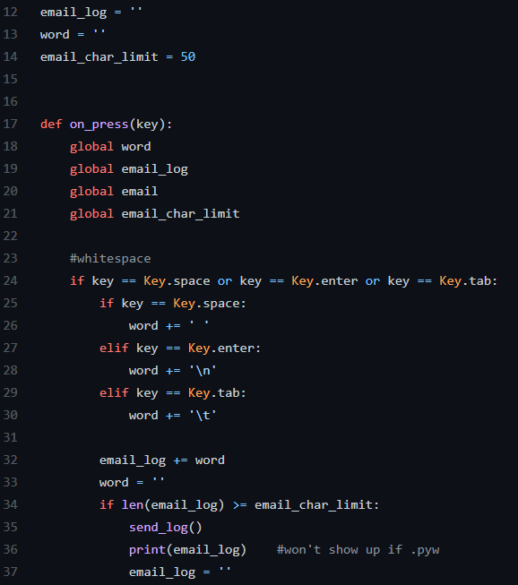
Key_logger.pyw
Lines 12-14 set up variables for
Storing email value
Storing key values
Setting email char limit
on_press(key)
Collects input of the keys a user presses
email_log += word
Stores the values to be emailed
Line 34 checks to see if the email limit has been reached
Notes:
Storing email contents
Storing key output values
Setting email char limit
-50 for testing
Starting at line 17, and going to line 86, on_press(key)
-Collects input of the keys a user presses
-Translates into an easily readable format (ie Key.f1 -> [F1])
Line 34 checks to see if the email limit has been reached
-if reached or surpassed, sends an email

Slide 8
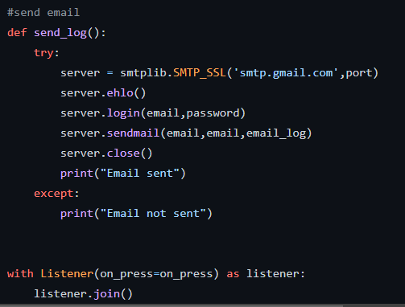
Key_logger.pyw
This code sends the email to our gmail created for logger
It uses smtplib to send the messages from python to gmail
Sendmail(<from>,<to>,<message>)
With Listener
Is used with on_press to get the user key values
Notes:
sends the email to our gmail account created for the keylogger
Listener with onpress used to collect keyboard events

Slide 9
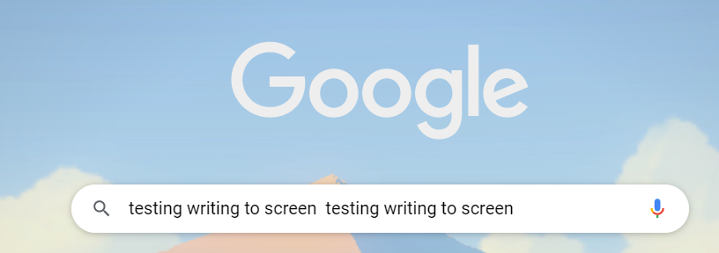
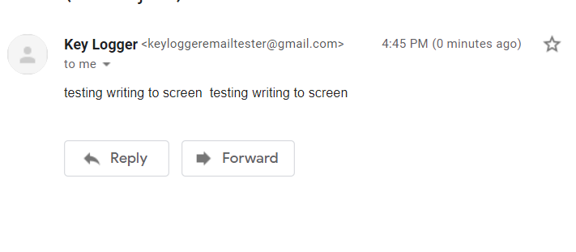
Notes:
-quick little example of how it works
-victim has typed into the google searchbar while keylogger is active
-after 50 chars (52 to be exact), keylogger sent an email of what victim typed

Slide 10
Challenges
Getting the keylogger to send emails to the gmail account
1
Gmail has extra security measures that had to be disabled
Getting the Program to capture screen shots of the user's screen
2
Notes:
-allow less secure apps to access your Google Account
-2 working on

Slide 11
Keylogger Prevention : Detection
Hardware
- Check for any unknown item plugged into your computer (cords, USB drives)
Software
- Slower computer performance when browsing/starting programs
- Abnormal delays in activity
- Pop-ups
- New desktop icons
- Excessive hard drive and network activity
Notes:
-here is some general info on how to protect against keyloggers
SW
-I noticed that when the keylogger was running, my cursor sometimes disappeared when I typed

Slide 12
Keylogger Prevention : Protection
Do not open attachments or download files from unknown sources
Watch out for phishing scams
Two-factor authentication
Anti-spyware programs (for software keyloggers)
Use a password manager
When logging into important websites use a virtual keyboard
Notes:
Most of this is good cyber hygiene in general.
Use 2FA when available
Anti spyware & malware programs
- When I first downloaded the keylogger to work on it more after Lauren had already started it, windows defender detected and removed it
Important websites, such as banking sites
Virtual keyboard, if you are afraid of a keylogger. Some loggers do not account for virtual keyboards – but some do

Slide 13
Questions?
Resources used:
Pynput library: https://github.com/moses-palmer/pynput

